Slide 1
ONLINE SHOPPING SYSTEM
Capstone Project review -1
BATCH NUMBER:4
Presented by:
25B11AIB52 - S Tejaswini - AIML
25B11AIB84 - T Devi Phanitha - AIML
25B11AI128 – Bh Sai Anusri Varma - AIML
25B11AI863 - P Krishna Kumari - AIML
25B11AI957 - P Madhu Shalini - AIML
Academic Year: 2026-2027
Under esteemed guidance of
Dr P Kishorekumar
Associate Professor
Department of AIML
Aditya University

Slide 2
Outline
Introduction
Problem statement
Objectives
System scope
Entities and Attributes
Relationships and Cardinality
Relational Database Schema
ER Diagram
Team Responsibilities and GitHub
Conclusion
2

Slide 3
1. Introduction
An Online Shopping System is a website or mobile application that allows people to search for products, compare them, add them to a cart, and buy them online.
It also provides features like product reviews, ratings, offers, and order tracking.
The system manages different users such as customers, sellers, administrators, warehouse staff, and delivery partners.
A DBMS (Database Management System) is used to store and manage important information such as user details, products, prices, orders, payments, stock, and delivery details.
The database helps keep the information organized, accurate, secure, and consistent.
It also ensures that activities like placing an order, making a payment, and updating stock are completed correctly without errors.
2

Slide 4
2. Problem Statement
Data problems: Customer, product, order, payment, and delivery information are stored separately, which can cause duplicate .
Inventory problems: Stock is not updated in real time, so a product may be sold even when it is out of stock.
Slow order processing: Manual order and payment processes take more time and can lead to mistakes and delivery delays.
Transaction problems: If a payment or order fails, the system may not properly update all the related information, causing inconsistent data.
Therefore, we need an integrated e-commerce system that manages data, inventory, orders, payments, and deliveries accurately and efficiently.
3

Slide 5
3. Objectives
Create a well-organized database.
Keep transactions safe and accurate.
Protect user information Update stock in real time.
Keep records of important activities.
Make the system scalable and reliable .
4

Slide 6
4. System Scope
Customer
Customer buys products online
Category
Category groups similar products
Product
Product is an item sold online
Address
An address shows where customer lives or receives the order
Orders
An order records what customer buys
Cart
stores products the customer wants to buys
Payment
Payment records how the customer pays
Shipment
Shipment records how the order is delivered
Review
Shows what a customer thinks about a product
5

Slide 7
5. Entities and Attributes
Nine entities identified for the proposed database
Entity | Key attributes
Customer | Customer_ID(PK), Customer_Name, Email, Phone, Password
Category | Category_ID(PK), Category_Name, Description
Product | Product_ID(PK), Product_Name, Description, Price, Stock_Quantity, Brand, Category,_ID(FK)
Address | Address_ID(PK), Customer_ID(FK), House_NO, Street, City, State, Pincode
Orders | Order_ID(PK), Customer_ID(FK), Address_ID(FK), Order_Date, Toatl_Amount, Order_Status
Next Slide....

Slide 8
5. Entities and Attributes
Nine entities identified for the proposed database
Entity | Key attributes
Cart | Cart_ID(PK), Customer_ID(FK), Product_ID(FK), Quantity, Added_Date
Payment | Payment_ID(PK), Order_ID(FK), Payment_Method, Payment_Date, Amount, Payment_ID, Trasaction_ID
Shipment | Shipment_ID(PK), Order_ID(FK), Courier_Name, Tracking_Number, Shipment_Date, Delivery_Date, Shipment_Status
Review | Review_ID(PK), Customer_ID(FK), Product_ID(FK), Rating, Review_Text, Review_Date

Slide 9
6. Relationships and Cardinality
Relationship | Cardinality | Meaning
Customer → Address | 1 : M | One customer can have many addresses.
Customer → Orders | 1 : M | One customer can place many orders.
Address → Orders | 1 : M | One address can be used for many orders.
Category → Product | 1 : M | One category can contain many products.
Orders → Payment | 1 : 1 | One order has one payment.
Orders → Shipment | 1 : 1 | One order has one shipment.
Customer → Review | 1 : M | One customer can write many reviews.
Product → Review | 1 : M | One product can have many reviews.
Customer → Cart | 1 : M | One customer can have many cart items.
Product → Cart | 1 : M | One product can be added to many carts.
7

Slide 10
7. Relational Database Schema
CUSTOMER | Customer(Customer_ID, Customer_Name, Email, Phone, Password) | PK:Customer_ID
CATEGORY | Category_ID, Category_Name, Description | PK:Category_ID
PRODUCT | Product_ID, Product_Name, Description, Price, Stock_Quantity, Brand, Category,_ID | PK:Product_ID | FK:Category_ID
ADDRESS | Address_ID, Customer_ID, House_NO, Street, City, State, Pincode | PK:Address_ID | FK:Customer_ID
ORDERS | Order_ID, Customer_ID, Address_ID, Order_Date, Toatl_Amount, Order_Status | PK:Order_ID | FK:Customer_ID , Address_ID

Slide 11
7. Relational Database Schema
CART | Cart_ID, Customer_ID, Product_ID, Quantity, Added_Date | PK:Cart_ID | FK:Customer_ID , Product_ID
PAYMENT | Payment_ID, Order_ID, Payment_Method, Payment_Date, Amount, Payment_ID, Trasaction_ID | PK:Payment_ID | FK:Order_ID,
SHIPMENT | Shipment_ID, Order_ID, Courier_Name, Tracking_Number, Shipment_Date, Delivery_Date, Shipment_Status | PK:Shipment_ID | FK:Order_ID
REVIEW | Review_ID, Customer_ID, Product_ID, Rating, Review_Text, Review_Date | PK:Review_ID | FK:Customer_ID, Product_ID

Slide 12
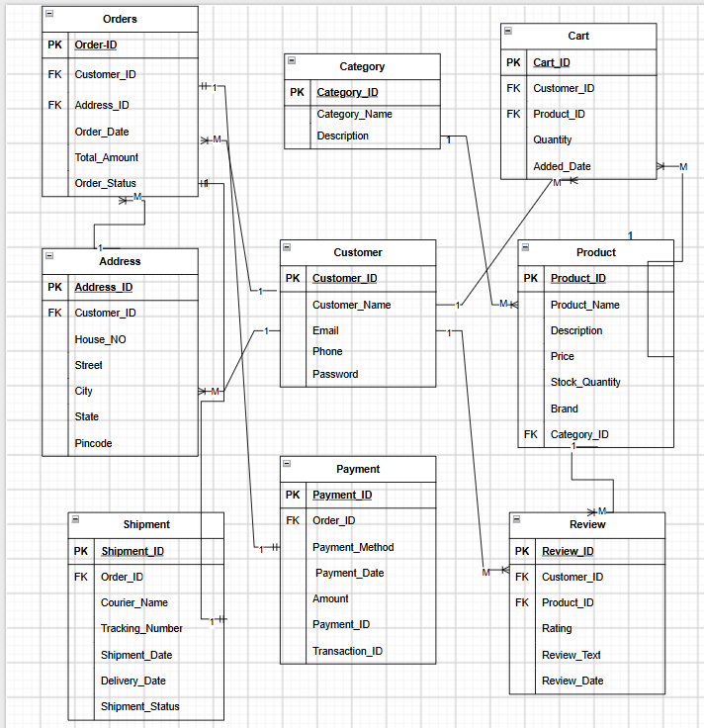
8. ER Diagram
Conceptual database design – six entities and their relationships

Slide 13
9. Team Responsibilities and GitHub
Team Member | Assigned responsibility
S Tejaswini | Project title, introduction
T Devi Phanitha | Problem Statement, Objective
P Madhu Shalini | Scope, and entity identification, Attributes, Primary Keys, and Foreign Keys,
P Krishna Kumari | Relationships and cardinality, Relational schema and ER diagram
Bh Sai Anusri Varma | GitHub repository and PPT documentation, Conclusion
GitHub Repository: Add the repository name and link here
10

Slide 14
10. Conclusion
The Online Shopping System is an effective database-based application designed to simplify and manage the complete online shopping process. The system provides a convenient platform for customers to browse products, view product details, add products to a shopping cart, place orders, and make payments. At the same time, administrators can manage customers, products, categories, orders, payments, and inventory through a centralized database.
The use of a Database Management System (DBMS) plays an important role in this project by providing efficient storage, organization, retrieval, and management of data. Relationships between different entities such as customers, products, orders, and payments can be maintained using primary keys and foreign keys. Proper database design and normalization help reduce data redundancy and maintain data consistency and integrity.
11

Slide 15
THANK YOU

